Slide 1
SFY Recommendations for MA P.O.S.T. De-Escalation Guidance
June 2021
Notes:
Introduction –
you’ve learned how the teen brain reacts differently than an adult’s brain
You’ve learned that mental illness and trauma can dramatically affect how kids respond to figures of authority
You’ve learned how the environment a kid grows up in can have a big impact on that kid
At the end of the day, however, you are in a job that requires you to assert your authority…
Let’s look at some ideas that can help

Slide 2
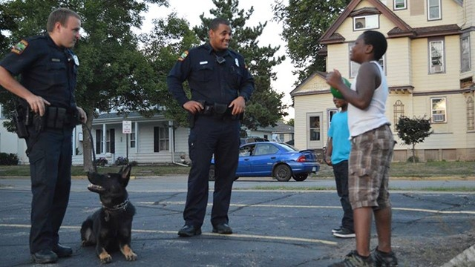
Strategies for Youth
A national, nonprofit policy and training organization dedicated to
improving police/youth interactions
and
reducing disproportionate minority contact.
Notes:
This is who Strategies for Youth is.
A non profit that has been around for over 10 years, has taught this curriculum to thousands of law enforcement officers in over 20 states.

Slide 3
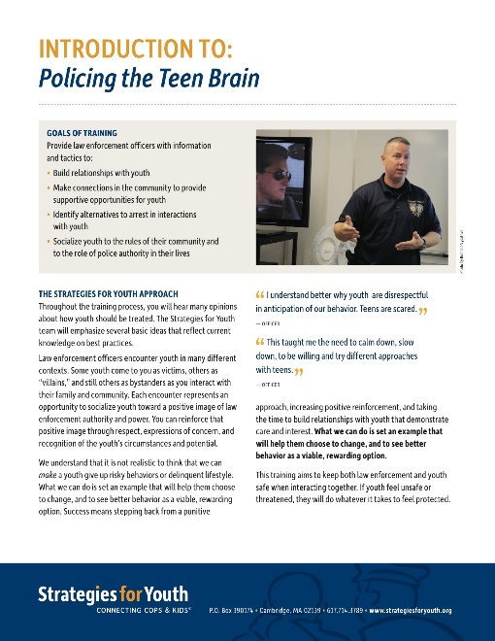
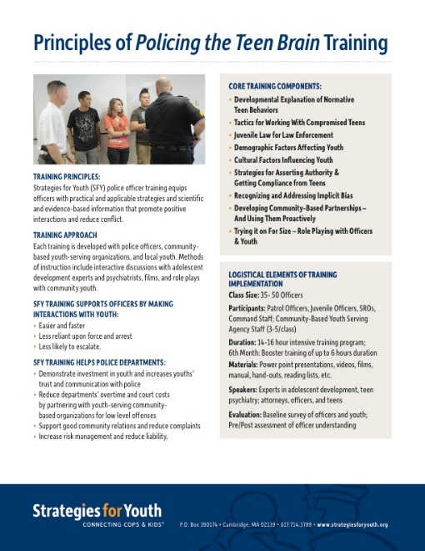
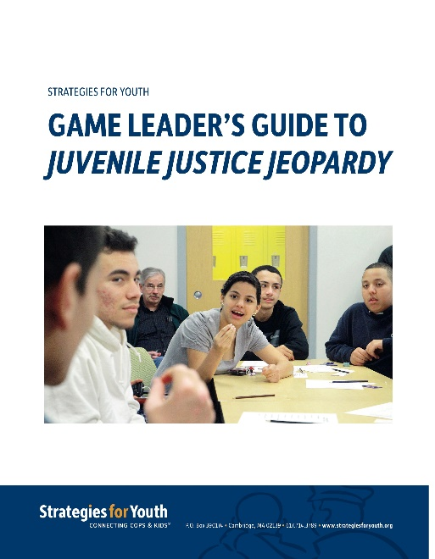
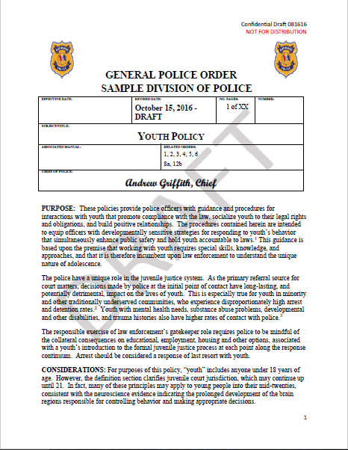
Training Law Enforcement
Policing the Teen Brain In the Presence of Children
Policies
Developmentally Appropriate,
Trauma-Informed, Racially Equitable
Outreach to Youth:
Juvenile Justice Jeopardy
Policy & Research
If Not Now, When?
Where’s the State?

Slide 4
Teens Can Be Difficult
Their brains are changing and work differently.
Notes:
Perceive, process and respond differently.
Key point: teens are difficult by nature and this training will give you some information you need to avoid escalation and de-escalate interactions with youth.

Slide 5
Teen Brains Are Still Developing
UNDER CONSTRUCTION
immature
reactive
uninformed

Slide 6
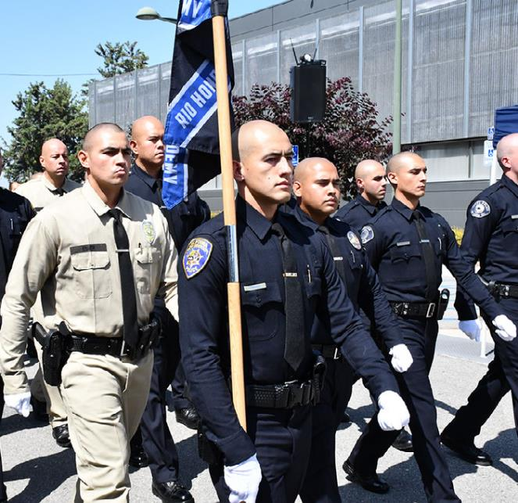
How are police trained?
Take control quickly
Punish defiance
Anticipate misconduct
Assume intentionality
Be “Transactional”

Slide 7
Causes of escalated responses:
Taking control quickly
Punishing defiance
Anticipating misconduct
Assuming intentionality
Being “Transactional”
Notes:
Ask the question “how are we trained to the class” and let it turn into a conversation, then present the bullet points
The academy teaches you to deal with issues in a transactional and efficient manner.
When you go to a domestic violence call you’re not initially concerned with the fact that dad has been unemployed for 6 months and the car needs new tires and the baby is out of diapers… you are focused on stopping harm if it is happening and resolving the problem.
You go where dispatch tells you to… joke with the students about getting a call and responding “Um, dispatch – I’m just not feeling it today. Send someone else.”
Finally, you are going into calls with an awareness that the public doesn’t have – you have to anticipate the unexpected and rarely do people “accidentally” break the law!

Slide 8
Specific LE Tactics That Escalate
Provocation
Disrespect
Accusations
Stop/Frisks for No Reason
Challenge masculinity
Cursing
Threats

Slide 9
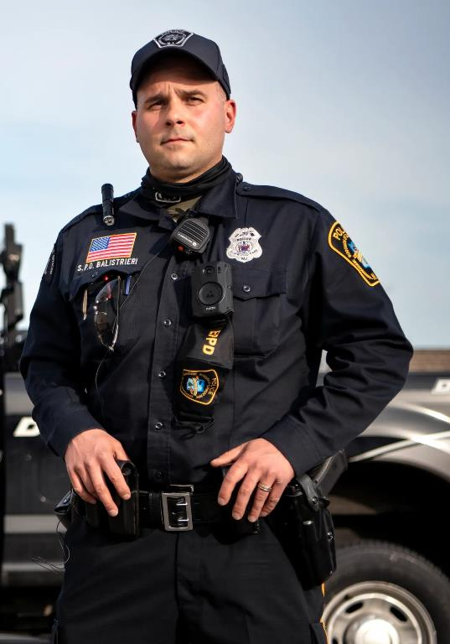
Just Being There
Officers’ uniform triggers response
Fears of not being
heard
treated fairly
More uniforms trigger more fear

Slide 10
Youth Responses to Officers:
Expectations of officers’ treatment inform youths’ response
Increased sense of powerless leads to:
Defensiveness
Flight
Fight

Slide 11
Best Tactics for Interactions with Youth
Notes:
So, what CAN you do?

Slide 12
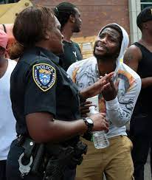
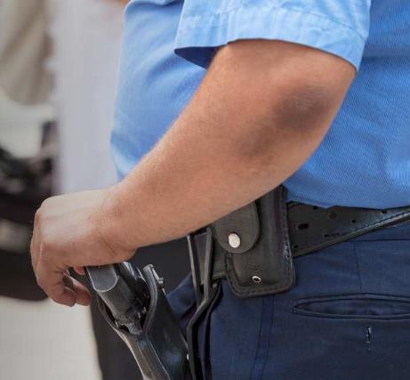
Before you can de-escalate…
What is escalated?
The youth?
You?
The situation?

Slide 13
Before you can de-escalate…
What is escalated?
The youth?
You?
The situation?
Why is the youth experiencing an escalated response and what can you do to reduce it?

Slide 14
Priority: Show Care & Concern
Assess youth’s condition (high, in crisis, abused, lacking options, etc.)
Look for cognitive and/or mental health issues
Consider potential trauma exposure and youths’ responses
Identify external sources of agitation

Slide 15
Before you can de-escalate…
What is escalated?
The youth?
You?
The situation?
How does your
Behavior
Language
& Timing
Affect the youth’s perception of the encounter?

Slide 16
Priority: Role as Neutral Problem-Solver
Emphasis on non-custodial response, trouble-shooting, conflict resolution
Neutral Approach
Consider the Source of Reason for Encounter
Call for service
Patrol Observation
Notes:
Acknowledge youth’s fear/anxiety
Be willing to ask “why”
Recognize that most calls for service are not criminal – family, relationship issues.

Slide 17
Priority: Problem Solver
Behaviors:
Reduce Sense of Threat
Confirm non-aggressive posture
Be aware of non-verbal communication
Consider perception of threat
How will inviting back-up affect the situation?
Other adults available to support effort?

Slide 18
Priority: Problem Solver Cont’d.
Language:
Answer ”why”
Be an active listener
Language – express concern,
Clarify options: situation/alternatives/consequences
Expect Up
Avoid threats

Slide 19
Priority: Problem-Solver
Timing:
Slow is fast
Kids process information/situations at different speeds
Speed leads to transactional response and increased sense of powerlessness among youth

Slide 20
Before you can de-escalate…
What is escalated?
The youth?
You?
The situation?
What is happening?
Are you situationally aware of what is happening that may be impacting the youth’s reaction to you?

Slide 21
Priority: Reduce Escalators
Recognize the difference between calls for service and course of duty interactions:
Be aware of the power dynamics in Calls for Service
Recognize youth’s perception of the interaction
Identify and remove external agitators
Separate youth from audience
Separate your response to the youth from your response to the situation
Notes:
Person making call for service may be the escalated one and have their own agenda.

Slide 22
Guidance Checklist: Key Elements
Recognition of Developmental Differences
Emphasize Role of Trauma
Role of Officer: Goal of Interaction
Articulate Chosen Tactics
Behavior
Language
Timing
Alternatives
Resolution of Interaction

Slide 25
De-Escalation Guidance Should:
Clarify developmental differences of youth and how that is expressed in behavior
Articulate Role of Officer
Peacekeeper/Commitment to Avoiding Arrest
Social Agent
“Here to help.”
Emphasize need to take into consideration all biases, including officer’s, involved.

Slide 26
Guidance Cont’d.
Taking time to assess situations
Adopt Procedural Justice approaches
State with specificity officer conduct wanted:
Behaviorally
Language
Timing
Warn against behaviors known to escalate

Slide 27
Guidance Cont’d.
Special emphasis: trauma
Racial/Ethnic minorities’ experiences, concerns, and fears
Traumatized responses should not be confused with guilt
Officers’ racial/gender biases lead to interpretations that ignore youth’s trauma

